Slide 1
Time Complexity and Big O Notation
Sunil Gawali

Slide 2
Sub Topic of the Presentation
What is Algorithm?
What kind of problems are solved by algorithm?
What is Time and Space Complexity in algorithm?
What is asymptotic notations?
Examples.
Graph for all running complexities.
Recurrences.

Slide 3
What is Algorithm?
An algorithm is any well-define computation procedure that takes some value, or set of values, as input and produce some value, or set of values, as output.
An algorithm is a sequence of computational steps that transformed the input into the output.

Slide 4
What kind of problems are solved by algorithm?
Basic numerical algorithms eg:- Arithmetic problem.
Cryptographic algorithms eg:- Encryption and Decryption Algorithm.
Sorting and Searching algorithms eg:- Quick sort, Binary search.
Graph algorithms eg:- Navigation and Mapping System.
Computational geometry algorithms eg:- AutoCad, Adobe Photoshop.
Computer vision algorithms eg:- Scanning QR code.
Rendering algorithms eg:- video games and movies.

Slide 5
What is Time and Space Complexity in algorithm?
Time Complexity :-
The time complexity is the computational complexity that describes the amount of time it takes to run an algorithm.
Space complexity :-
The amount of space or memory taken by an algorithm to run as a function of the length of the input.

Slide 6
What is asymptotic notations?
Asymptotic notations are descriptions that allow us to examine an algorithm’s running time by expressing its performance as the input size, n, of an algorithm increases.
There are three asymptotic notations:-
Big ( O ) notation for worst case.
Theta ( Θ ) notation for average case.
Omega ( Ω ) notation for best case.

Slide 7
Big ( O ) notation
Big O, commonly written as O(n), is an asymptotic notation for the worst case.
The maximum amount of time required to solve a particular problem for a particular input.
It provides as upper bound for the runtime of an algorithm.

Slide 8
Theta ( Θ ) notation
Theta Θ, commonly written as Θ(n), is an asymptotic notation for the average case.
The average amount of time required to solve a particular problem for a particular input.
It provides with a tight bound for the runtime of an algorithm.

Slide 9
Omega ( Ω ) notation
Omega ( Ω ), commonly written as Ω(n), is an asymptotic notation for the Best case.
The minimum amount of time required to solve a particular problem for a particular input.
It provides with a lower bound for the runtime of an algorithm.

Slide 10
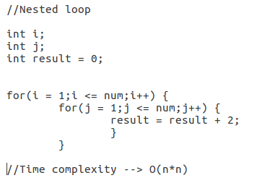

Examples 1

Slide 11
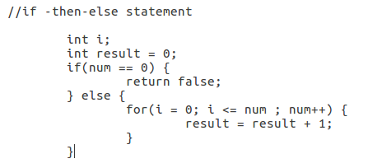
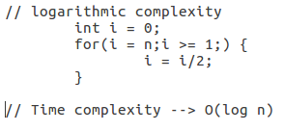
Examples 2

Slide 12
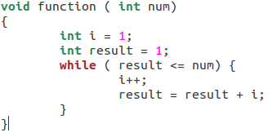
Example 3

Slide 13
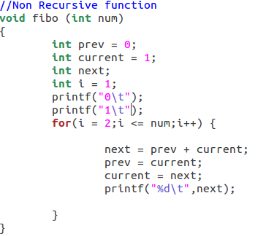
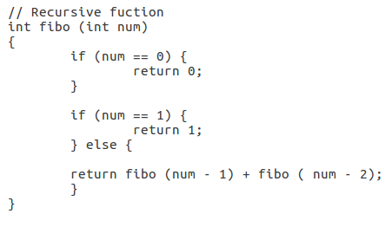
Examples 4

Slide 14
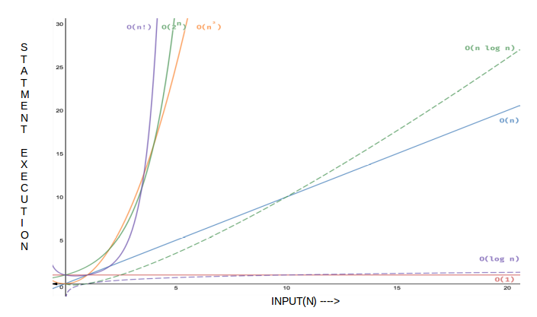
Graph for all running complexities

Slide 15
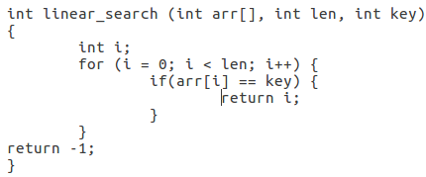
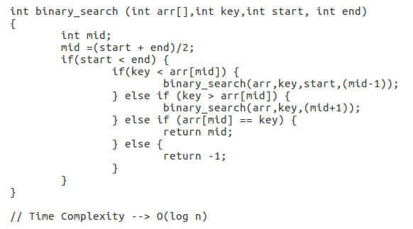
Examples 5

Slide 16
Recurrences.
Three types of recurrence solution are follows :-
  Substitution method.
  Recursion-tree method.
  Master method.

